Slide 1


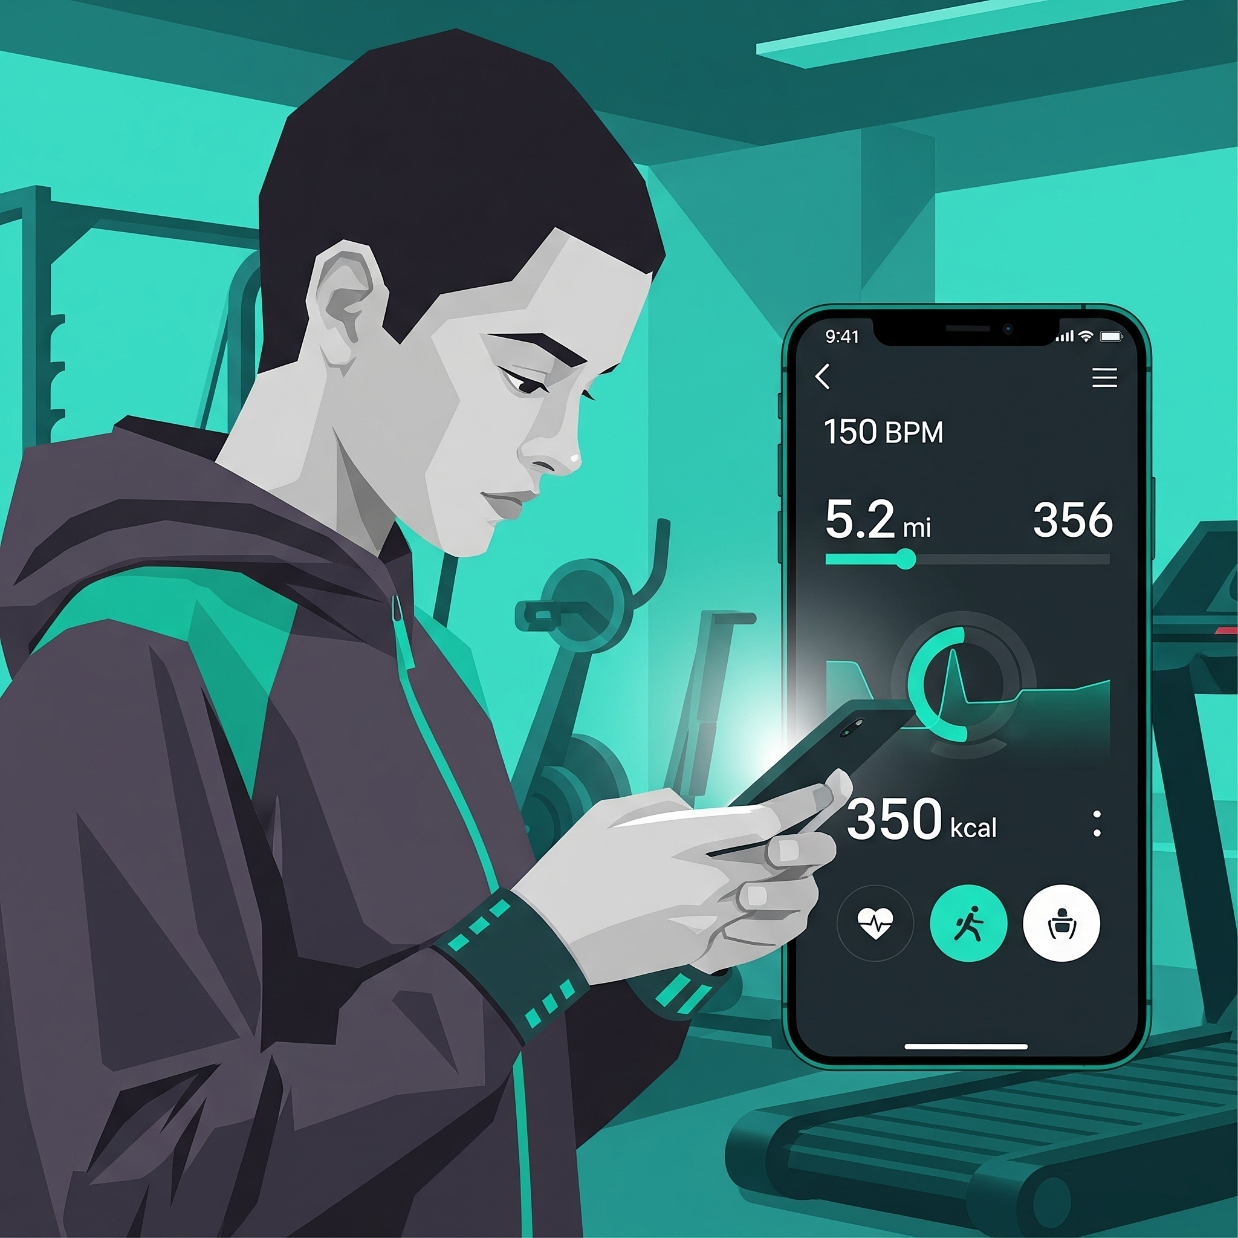
Student Fitness App
Final Project Presentation
Team 2 Members
• Grayson Jackson
• Jonathan Armstrong
• Lin Oldfield
• Alicia Johansen
• Michal Griffith

Slide 2
Project Overview
SCHOLAR STRONG
Our mission is to give students a chance to go to the gym who are either new to working out or have strict time frames.
TECH STACK
Core Stack
Jetpack Compose for UI
Material 3: Components
Navigation Compose: screen routing
Rooms: local SQLite database
KSP: Room code generation
Coroutines: async work
Security Crypto: secure PIN storage
YouTube player: workout videos
Architecture
MVVM pattern
Reactive data flow with Flow and Compose state
Platform & Language
Native Android app
Kotlin first, with Java 11 compatibility
Target SDK 36, min SDK 26
Gradle Kotlin DSL build system
REPOSITORY
https://github.com/modernswdev/team2-student-fitness-app
Notes:
Alicia

Slide 3
Team & Agile Process
SCRUM MASTER ROTATION
Grayson arrow_forward Lin arrow_forward Jonathan arrow_forward Alicia
BACKEND
Lin Oldfield
Jonathan Armstrong
FRONTEND
Alicia Johansen
Michal Griffith
FULL STACK
Grayson Jackson
Notes:
Alicia

Slide 4
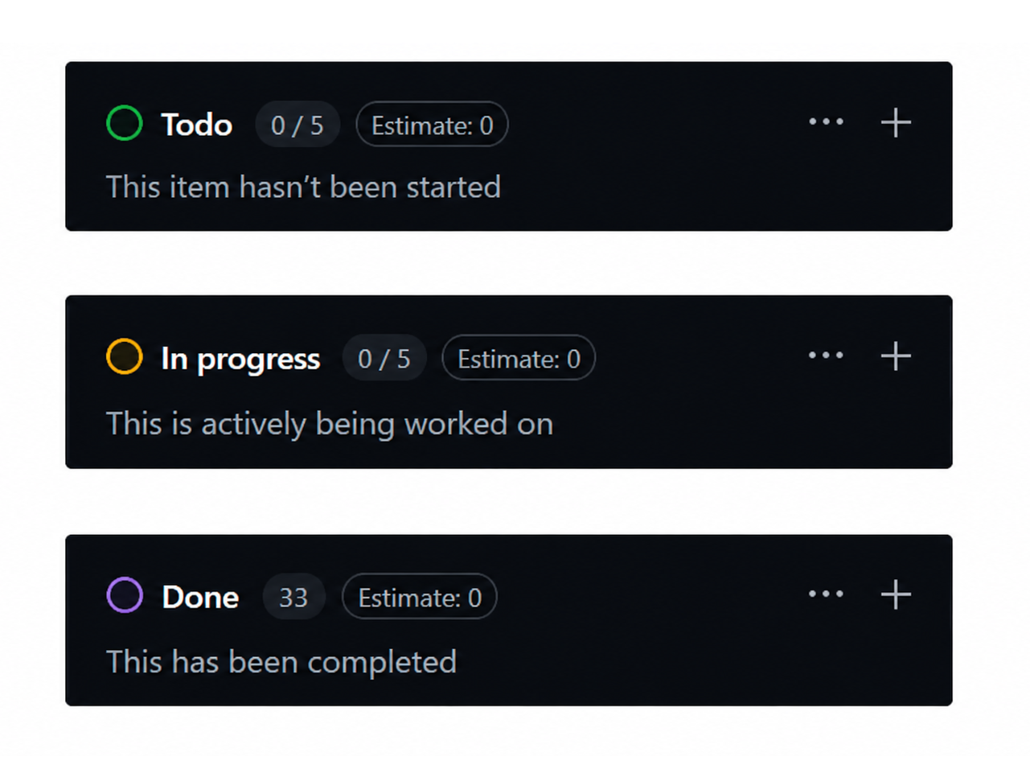
Kanban Board & Retrospectives
Kanban Board:
To Do In Progress Done
Tasks were assigned by Scrum Master based on the team’s needs during weekly meeting
Frontend & Backend worked independently of one another until integration
Retrospective:
Clarified order of priority
Fractionalized features into Sub-Issue Tickets
Reduced Task Ownership Confusion
Team Dynamic:
Individual work paces differ
Finding mutually available times
Notes:
Michal

Slide 5
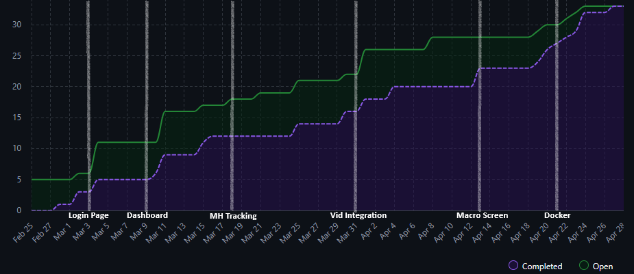
Kanban Board & Retrospectives
Notes:
Michal

Slide 6
Version Control
Branch Naming
Merge Strategy
Kebab-case naming scheme
Added creator name and numbers to similar branch names
  “AJohansen-code-patch-3”
Present-tense full descriptive name for commits
  “Implement dashboard and profile”
Created new branches for each feature
Merged branches into main upon feature completion
Add workout datasets
Fix Android CI Workflow
Enhance Dashboard UI
Main
Add README.md
Add Android Rooms
Move screen files
Rooms database setup
Notes:
Lin

Slide 7
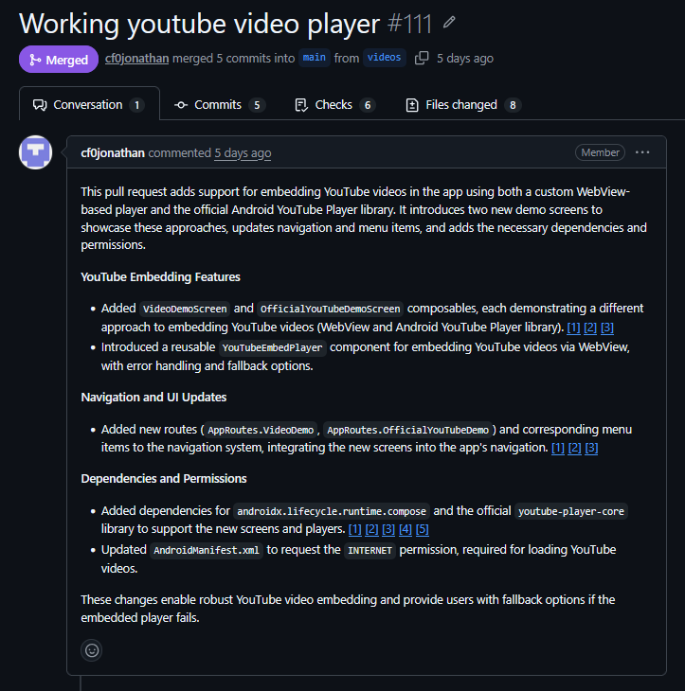
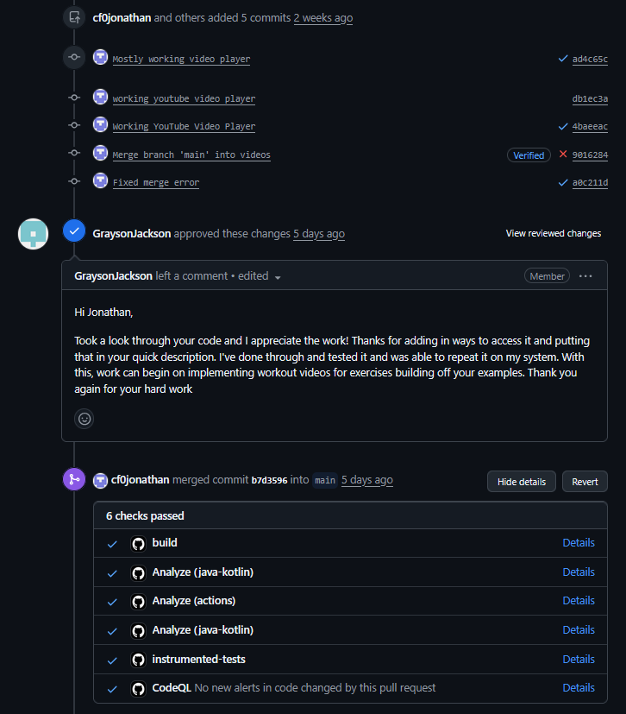
Version Control - Pull Request & Code Review
Notes:
Lin

Slide 8
Testing
Unit Tests
AAA pattern · JUnit4 · Kotlin · boundary values
← Most tests here
Integration Tests
Compose UI testing · Login Screen · mocking external deps
E2E / Functional
Full user flows · use sparingly
YOUR TEST SUITE — REPORT THE NUMBERS
9
9
N/A
Total Tests Written
Tests Passing
Coverage %
Notes:
Jonathan

Slide 9
Testing Strategy
RED
Write the failing test first
GREEN
Write just enough code to pass
REFACTOR
Clean up without breaking tests
Your test (written FIRST)
Your implementation
After refactor
@Test
fun testSetAndUnlockPin() {
// Arrange
assertFalse(
loginViewModel.isPinSet()
)
// Act
loginViewModel.setPin(1234)
// Assert
assertTrue(
loginViewModel.isPinSet()
)
assertTrue(
loginViewModel.pinUnlock(1234)
)
assertFalse(
loginViewModel.pinUnlock(5678)
)
}
fun setPin(pin: Int) {
pinManager.savePin(pin)
}
fun isPinSet(): Boolean {
return pinManager.hasPin()
}
fun pinUnlock(pin: Int): Boolean {
return pinManager.verifyPin(pin)
}
// Cleanup done after green:
// - Extracted SecurePinManager
// to handle all SharedPrefs
// PIN storage
// - Added resetPin(old, new)
// helper with old-PIN guard
// - Wired LoginViewModel
// into MainActivity via
// remember { } + LocalContext
// - Removed direct SharedPrefs
// access from ViewModel
Notes:
Jonathan

Slide 10
Testing YAML and Flow
Code
Push
→
GitHub
Actions
→
Install
Deps
→
Run
tests
→
✓ PASS
or ✗ FAIL
- name: Set up JDK 17 uses: actions/setup-java@v4 with: distribution: temurin java-version: 17 cache: gradle - name: Set up Android SDK uses: android-actions/setup-android@v3 - name: Make gradlew executable run: chmod +x ./gradlew - name: Build debug APK run: ./gradlew assembleDebug --stacktrace - name: Run unit tests run: ./gradlew test --stacktrace | instrumented-tests: runs-on: ubuntu-latest steps: - name: Checkout repository uses: actions/checkout@v4 - name: Set up JDK 17 uses: actions/setup-java@v4 with: distribution: temurin java-version: 17 cache: gradle - name: Set up Android SDK uses: android-actions/setup-android@v3 - name: Make gradlew executable run: chmod +x ./gradlew | - name: Enable KVM run: | echo 'KERNEL=="kvm", GROUP="kvm", MODE="0666", OPTIONS+="static_node=kvm"' | sudo tee /etc/udev/rules.d/99-kvm4all.rules sudo udevadm control --reload-rules sudo udevadm trigger --name-match=kvm - name: Run instrumented tests Uses: reactivecircus/android-emulator-runner@v2 with: api-level: 34 target: google_apis arch: x86_64 script: ./gradlew connectedAndroidTest --stacktrace
Notes:
Grayson

Slide 11
Docker/Kubernetes
🐳 DOCKER
☸ KUBERNETES
docker-compose.yml
kubernetes/build-apk-job.yaml
services:
app/build/outputs/apk/debug/*.apk
build:
build:
context: .
dockerfile: Dockerfile
command: ["./gradlew", "assembleDebug", "--no-daemon"]
volumes:
- ./app/build/outputs:/app/app/build/outputs
test:
build:
context: .
dockerfile: Dockerfile
command: ["./gradlew", "test", "--no-daemon"]
volumes:
- ./app/build/reports:/app/app/build/reports
emulator:
image: budtmo/docker-android:emulator_14.0
devices:
- /dev/kvm
ports:
- "6080:6080" # Web VNC — open in browser to view the emulator screen
- "5554:5554" # ADB console port
- "5555:5555" # ADB data port (for `adb connect localhost:5555`)
environment:
EMULATOR_DEVICE: "Nexus 5"
WEB_VNC: "true"
volumes:
- emulator-data:/home/androidusr
deploy:
resources:
limits:
cpus: "4" # Allow up to 4 CPU cores
memory: "4G" # Allow up to 4 GB RAM
reservations:
cpus: "2" # Reserve at least 2 CPU cores
memory: "2G" # Reserve at least 2 GB RAM
install:
build:
context: .
dockerfile: Dockerfile
depends_on:
- emulator
volumes:
- ./app/build/outputs:/app/app/build/outputs
entrypoint: ["/bin/bash", "/usr/local/bin/install-apk.sh"]
environment:
EMULATOR_HOST: "emulator"
EMULATOR_ADB_PORT: "5555"
volumes:
emulator-data:
apiVersion: batch/v1
kind: Job
metadata:
name: build-apk
namespace: student-fitness
spec:
backoffLimit: 0
ttlSecondsAfterFinished: 3600
template:
spec:
restartPolicy: Never
containers:
- name: build
image: student-fitness-android:local
imagePullPolicy: IfNotPresent
command: ["./gradlew", "assembleDebug", "--no-daemon"]
volumeMounts:
- name: build-artifacts
mountPath: /app/app/build
volumes:
- name: build-artifacts
persistentVolumeClaim:
claimName: build-artifacts-pvc
Notes:
Grayson

Slide 12
Live Demo Time
What we’ll show:
Login with PIN & account setup
Dashboard & gym hours lookup
Workout recommendations
YouTube workout tutorials & machine guides
Intake tracker
Guided breathing & mental wellness tools
Notes:
Everyone

Slide 13
Lessons learned - Team Reflections
Biggest Technical Challenges: Talking from two different worlds of coding. Applications , Android studios, having hiccups when working on it.
Process Challenges: Big aspirations with realistic results.
Most valuable thing learned: Having members of your team be knowledgeable in different subjects will help tackle any issue they might encounter in their projects. Teaching everyone a little of everything in web/mobile software development.
What Surprised you: That it takes a village to create an app, that every little piece makes a project functional. Also that having responsive team members makes the project less difficult to manage.
Notes:
Everyone

Slide 14
Questions & Answers
Thank you
Notes:
Everyone

